Slide 1
git

Slide 2
git
Version Control System
It track change in the file
git command
Multiple developers can work on a single project

Slide 3
git commands
git init
git add <file>
git add .
git status
git commit
git push
git pull
git clone

Slide 4
git install
Linux
sudo apt-get install git
Mac
http://git-scm.com/download/mac
Windows
http://git-scm.com/download/win

Slide 5
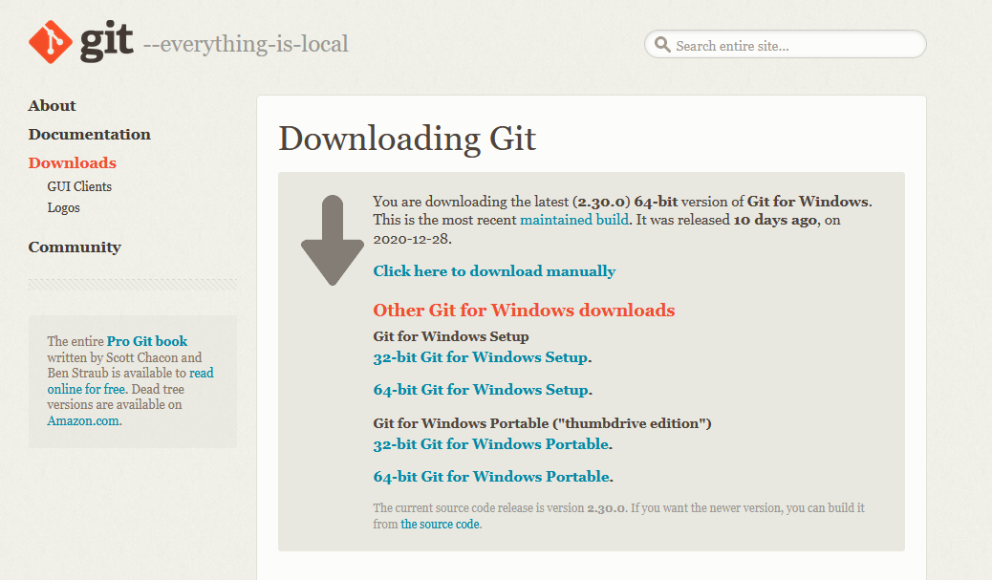
git for windows

Slide 6
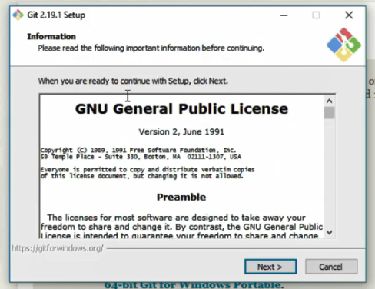
git for windows ( 64 bit )

Slide 7
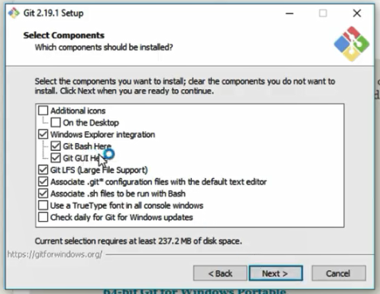

Slide 8
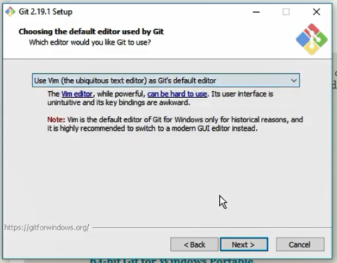

Slide 9
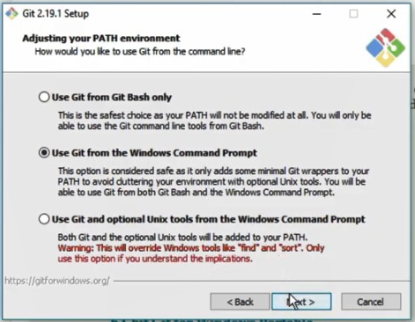

Slide 10
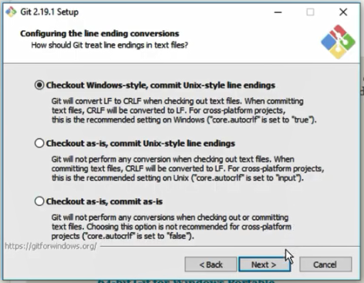

Slide 11
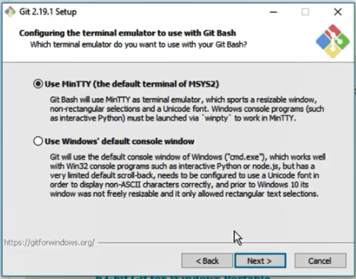

Slide 12
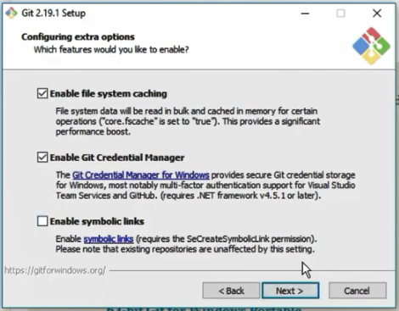

Slide 13
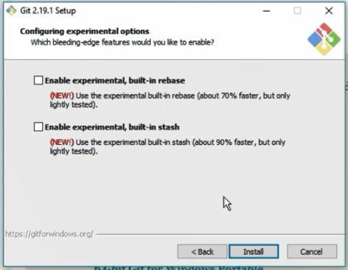

Slide 14
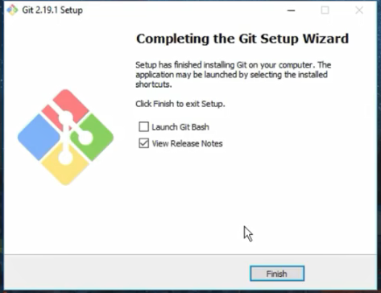

Slide 15
git commands
To check git installed or not
git --version
Windows extensions
Text file : txt
Document file : doc
PowerPoint file : pptx
Excel file : xlsx
Create a file using git bash
touch record.txt

Slide 16
git staging
To check tracking (staging)
git add <file>
To track
git add <file>
To track all
git add .
To untrack
git rm --cached <file>
To untrack all
git rm --cached -r .

Slide 17
git commit
add a message to a particular stage
git commit -m “messages”
git commit -m “ create students mark list”

Slide 18
gitignore
.gitignore
To avoid tracking of a particular file
Create a file name .gitignore
Add the file name to that file
Files : reference.txt
Refnot.txt
Folder : /myfolder
reference.txt
Refnot.txt
/myfolder

